Slide 1

Symmetric Boolean Functions using Threshold Logic Elements
presented by
Swarna Kamakshi Jayaraman, Deepshikha Bansal
M.Sc Embedded Systems
School of Computer Science and Engineering
15th September 2016

Slide 2
Symmetric Boolean Functions
A function is symmetric in its variables if its variables can be interchanged without affecting it.
e.g. AND,OR,XOR
(add the content and notation from our slide )
Notes:
Symmetric Boolean function : the value depends on the number of 1s in the input but not the permutation of input bits.

Slide 3
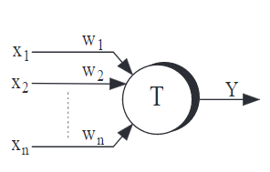
Majority Gates Vs. Threshold Gates
A threshold gate with m inputs is determined by m weights w1, w2, w3,……, wm and threshold T. The output will be one 1 if :
Eqn(summation)
A Majority gate is a threshold gate with unit weights & threshold is half the number of inputs.
Symbol of Threshold Gate

Slide 4
Needs a title:
A symmetric function can be realized by using threshold gates if the function can be defined as 'at least c 1’s among its inputs‘
Exception: XOR gate ( it doesn’t follow the rule)
Add the One-realizable thing to fill the slide. ( I am not able to add it is coming a image)

Slide 5
Early attempts
Minnick R.C, Linear input logic(1961): Procedures are developed for the synthesis of symmetric functions which require no more than the integral part of (n+3)/2 cores, approximately half the number used in previously published procedures.
Winder R.O., More About threshold logic(1961), Algorithm to provide 2-Realizability
Coates and Lewis: A Realization of threshold logic networks (1963),The new procedure can be considered to be a generalization of an earlier procedure for the single-element realization problem
Kautz. W.H: Realization of symmetric switching functions with linear input logic elements (1961),Any symmetric function of no more than 12 variables can be realized.
Sheng C.L. : Graphical Interpretation of realization of symmetric Boolean functions using threshold logic elements(1963): Same result as Kautz but successfully formulated for 37 variables. Can be extended for more variables.

Slide 6
Abstract
We will implement Symmetric Functions using Threshold gates, using the Graphical algorithm mentioned in the IEEE Journal :
“A Graphical Interpretation of Realization of Symmetric Boolean Functions with Threshold Logic Elements”, by C. L. Sheng, Senior Member, IEEE (Publication date)

Slide 7
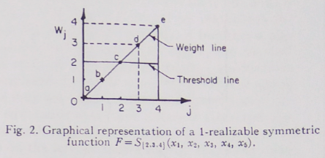
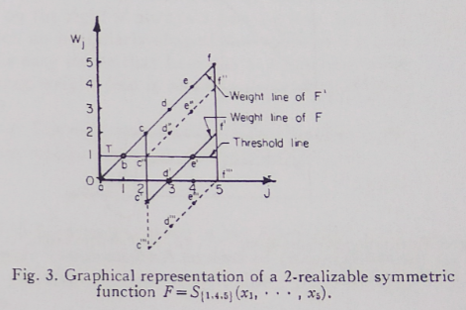
1-Realizable and 2- Realizable symmetric functions
The original weight line is a straight line with positive slope, passing through the origin (as weights as assumed to be unity).
After being indented by inhibitions (inputs with –ve weights) from previous stage elements, it becomes a zigzag line.

Slide 8
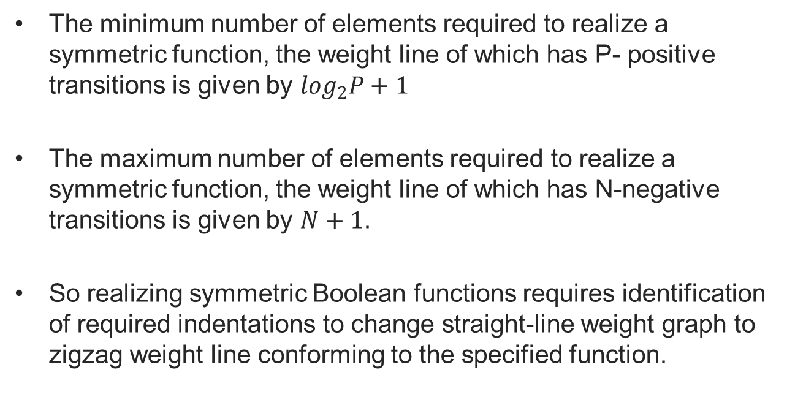
Conclusions from the algorithm

Slide 9
Objective
To Implement a C++ Program to realize a Symmetric Boolean Function using threshold gates with n-inputs, using the graphical algorithm mentioned in the IEEE Journal : “A Graphical Interpretation of Realization of Symmetric Boolean Functions with Threshold Logic Elements”s
To generate an n-input symmetric function threshold gates and compare the following attributes with the existing tool:
i. Number of gates
ii. Size of gates
iii. Depth of the network
iv. Execution time

Slide 10
Proposed Hardware and Software Tools
C++ with STL and Boost Graph libraries.
No hardware component.

Slide 11
Thank you.

